Slide 1
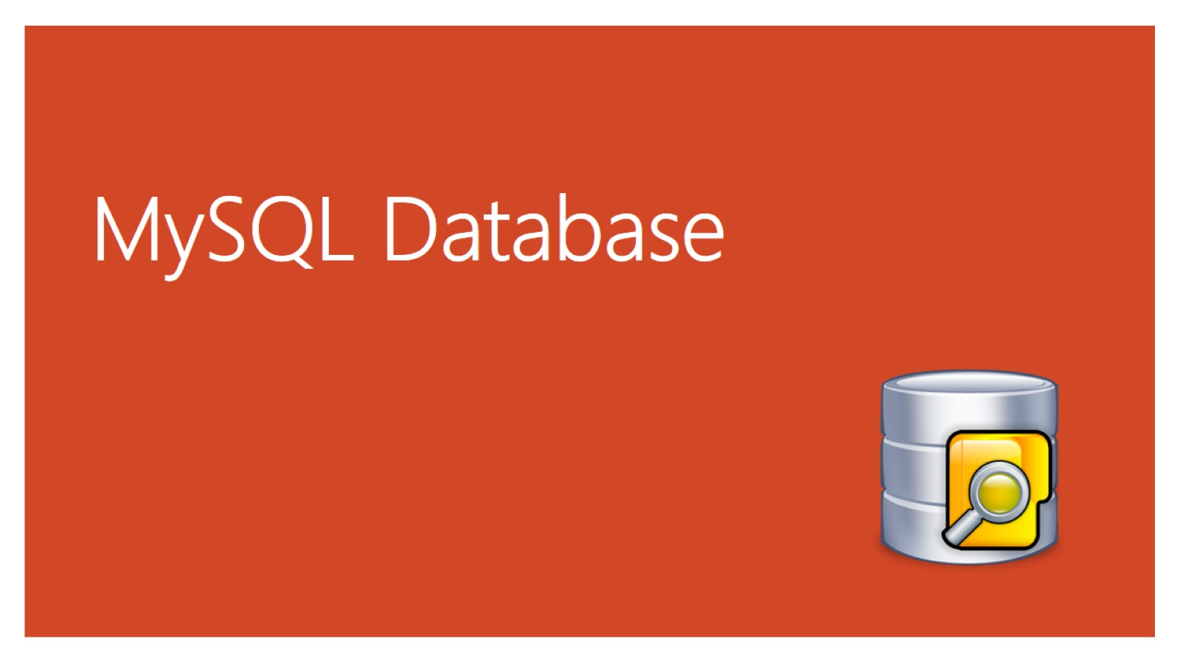
MySQL Database

Slide 2
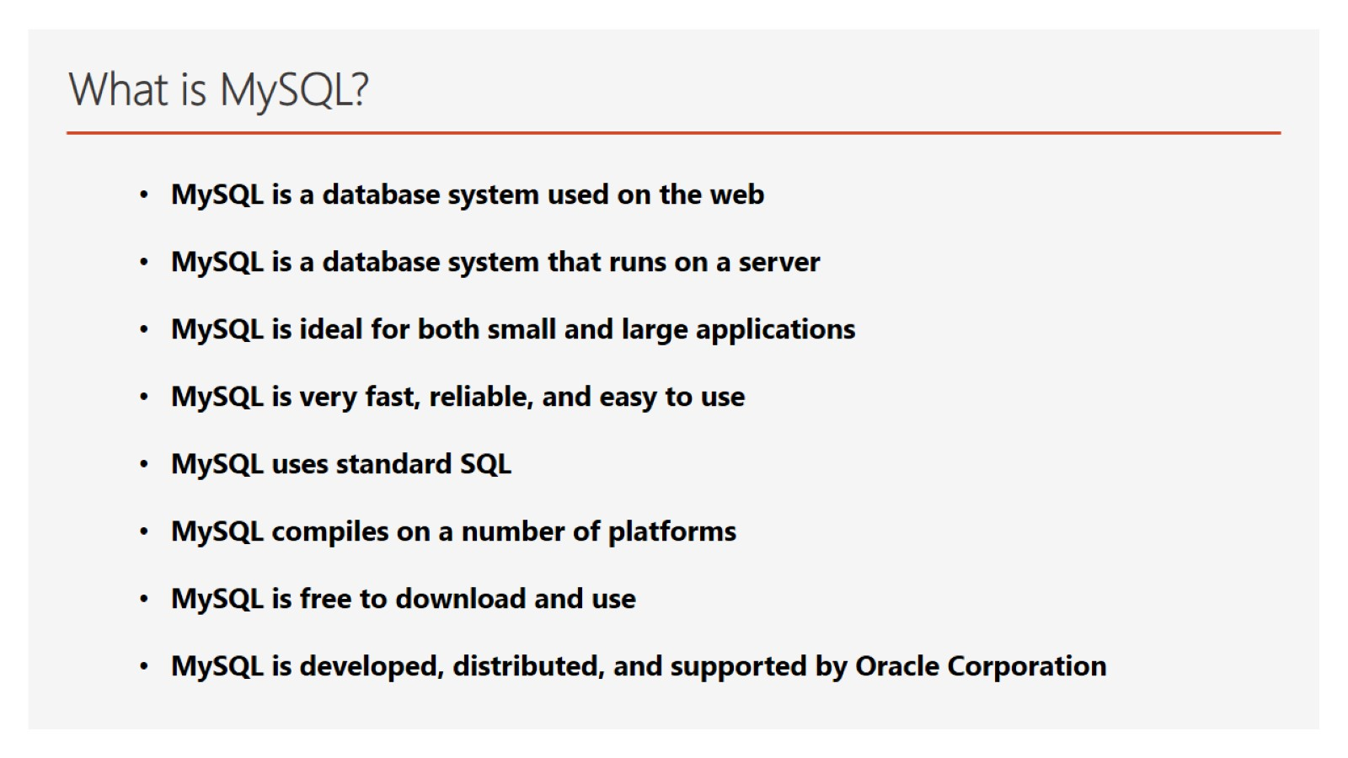
What is MySQL?

Slide 3
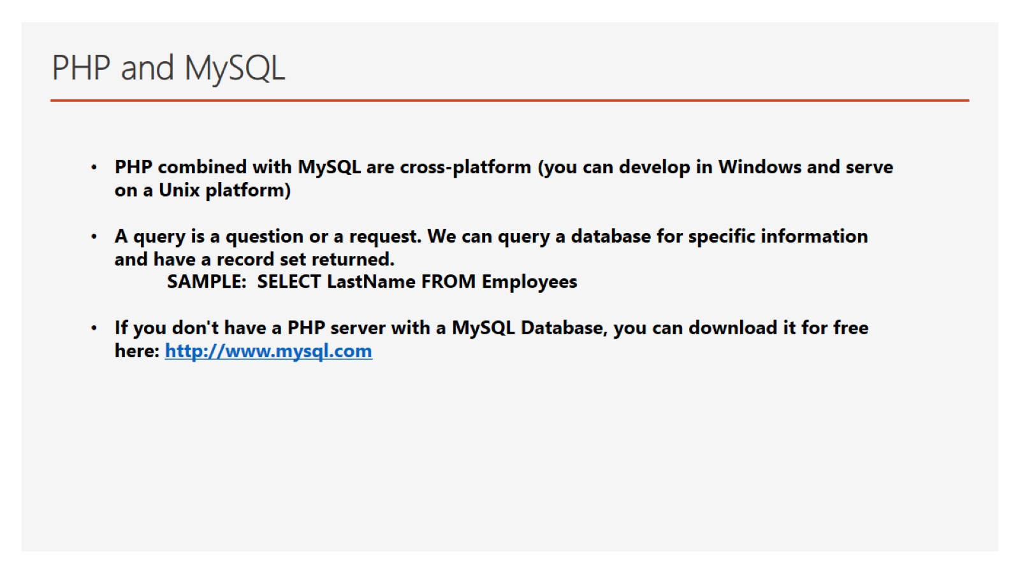
PHP and MySQL

Slide 4
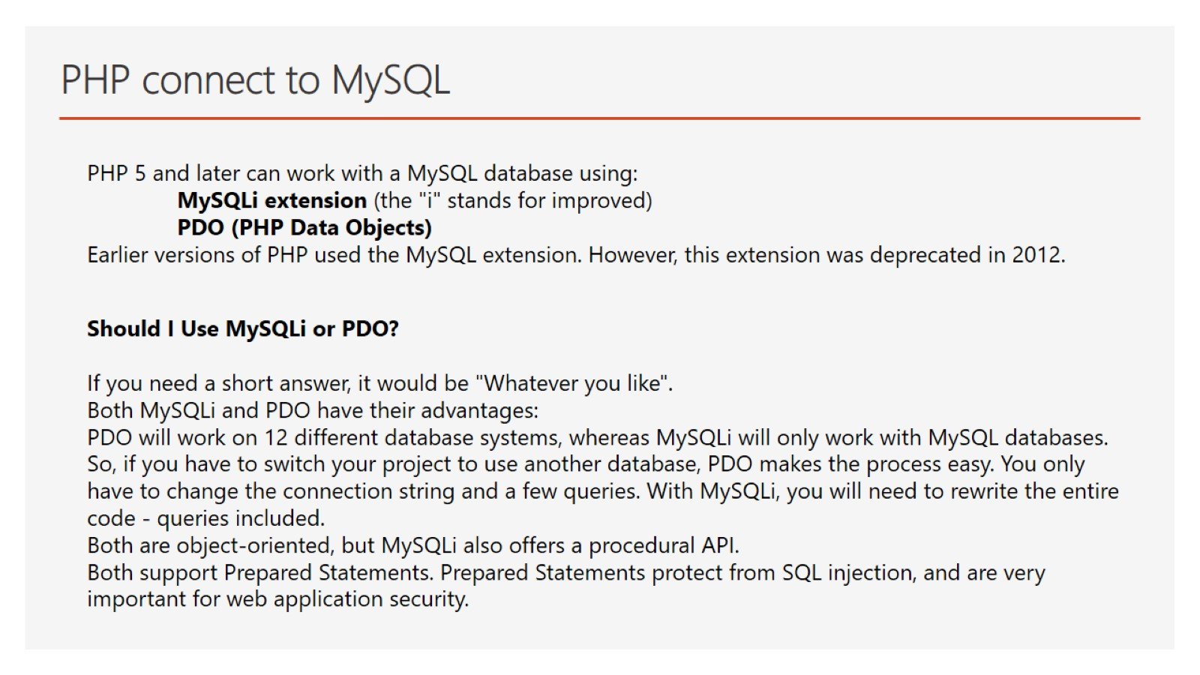
PHP connect to MySQL

Slide 5
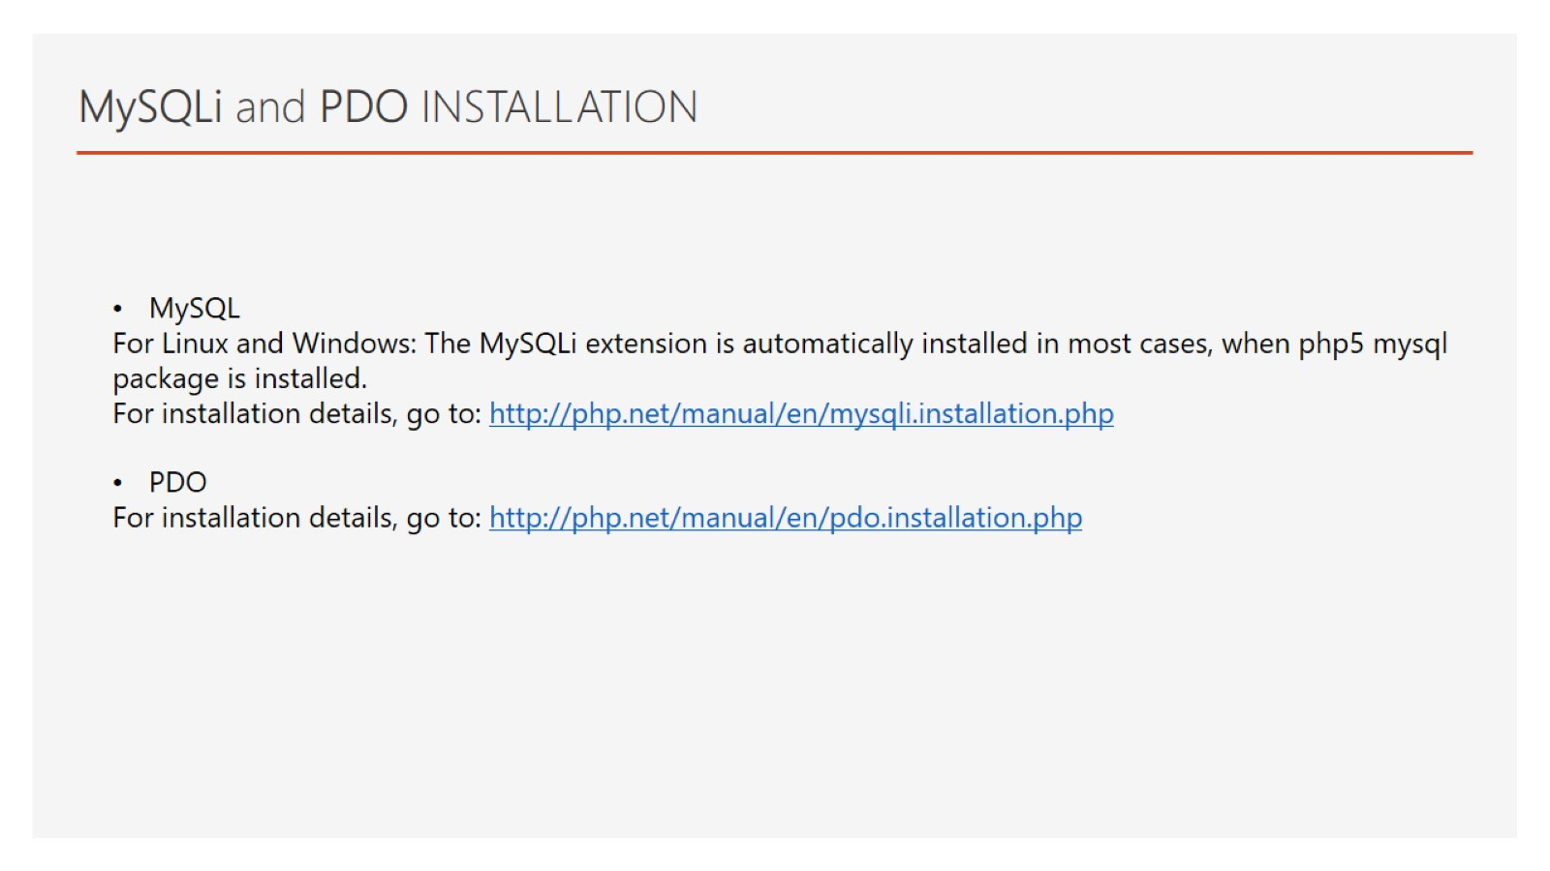
MySQLi and PDO INSTALLATION

Slide 6
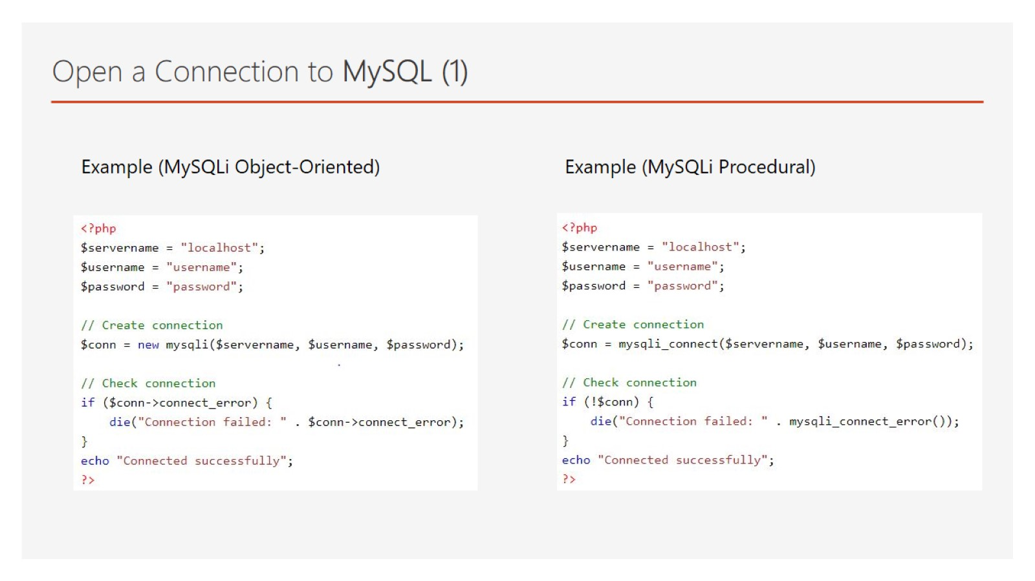
Open a Connection to MySQL (1)

Slide 7
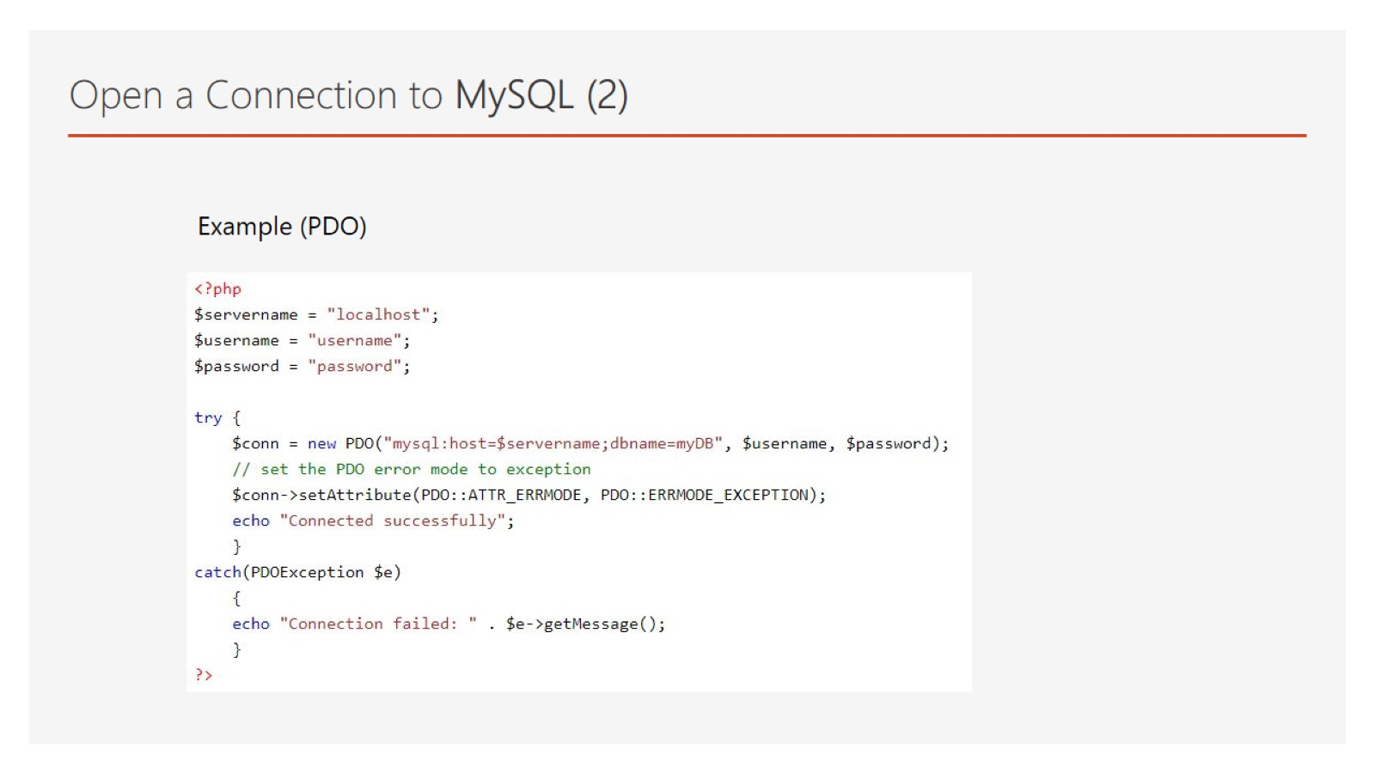
Open a Connection to MySQL (2)

Slide 8
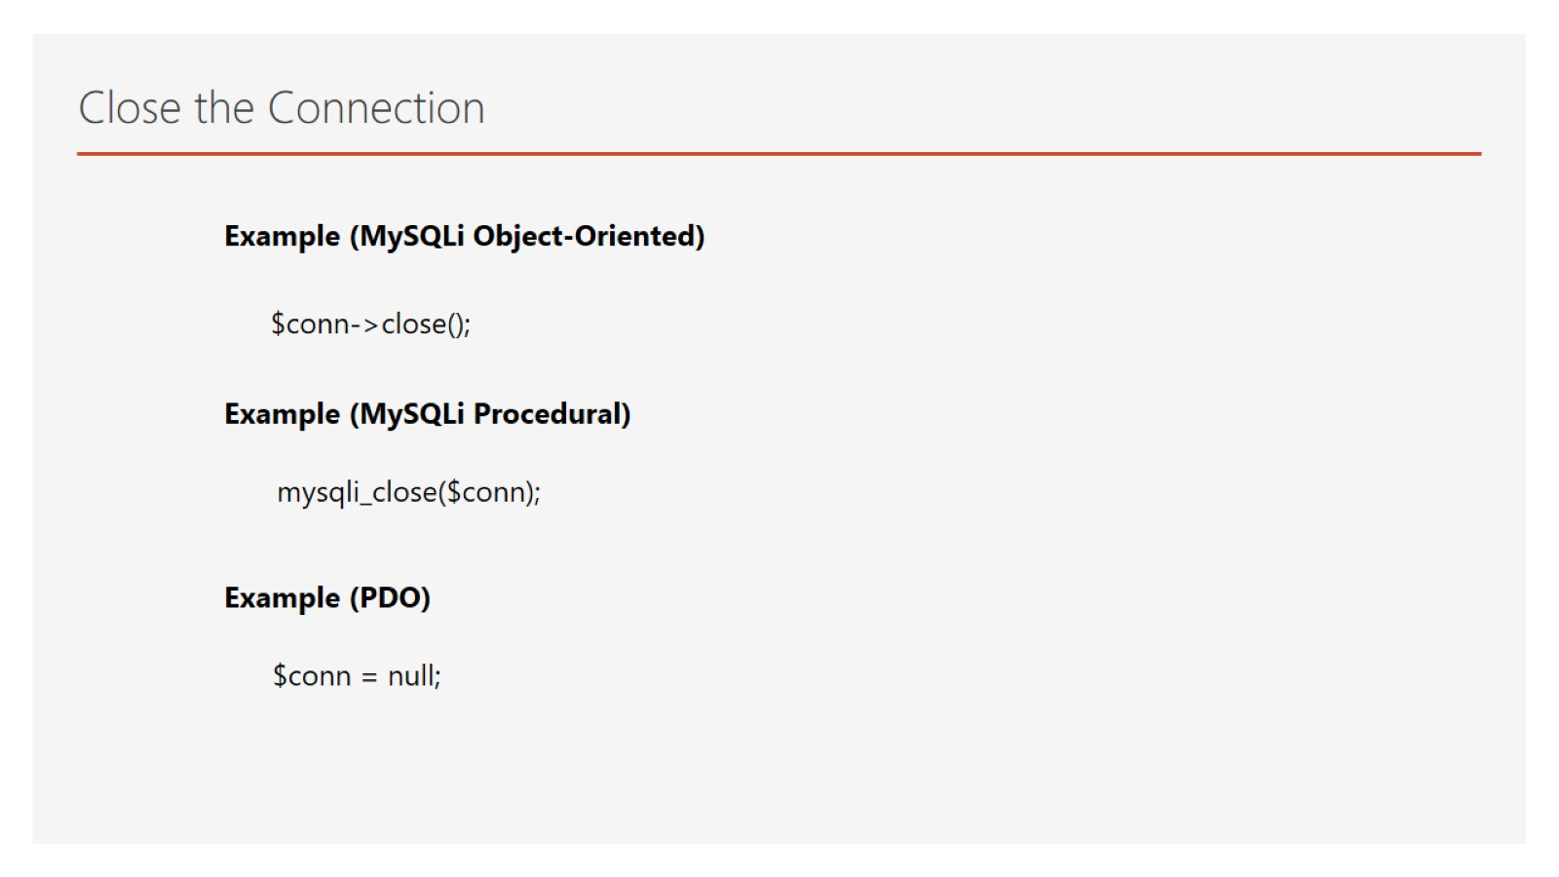
Close the Connection

Slide 9
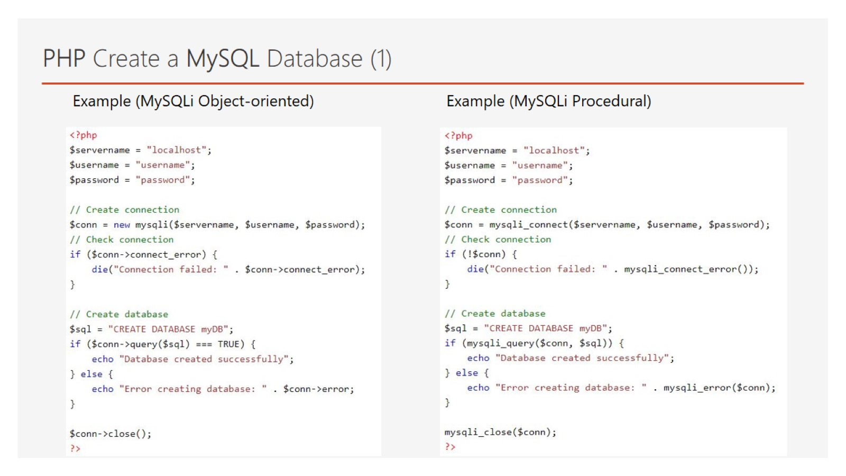
PHP Create a MySQL Database (1)

Slide 10
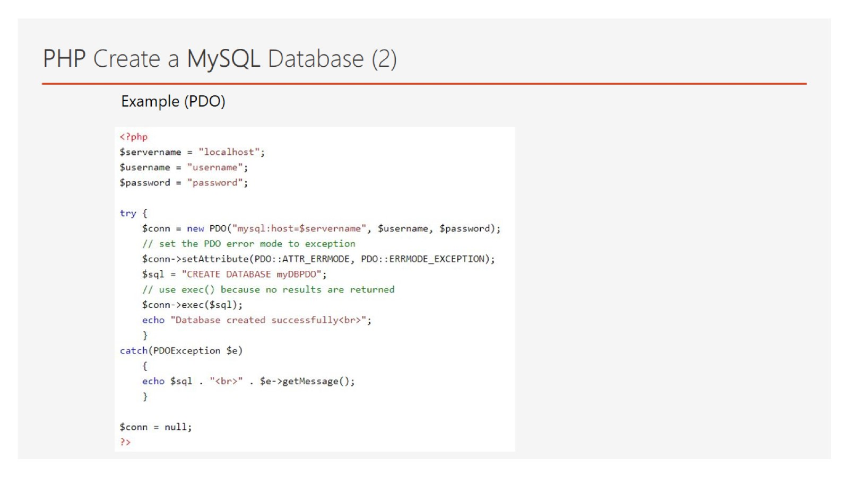
PHP Create a MySQL Database (2)

Slide 11
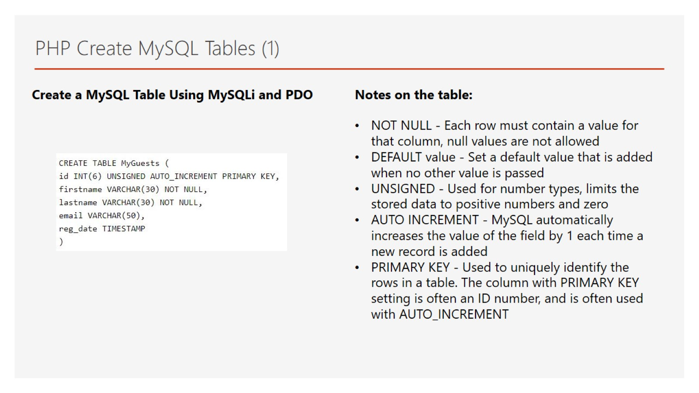
PHP Create MySQL Tables (1)

Slide 12
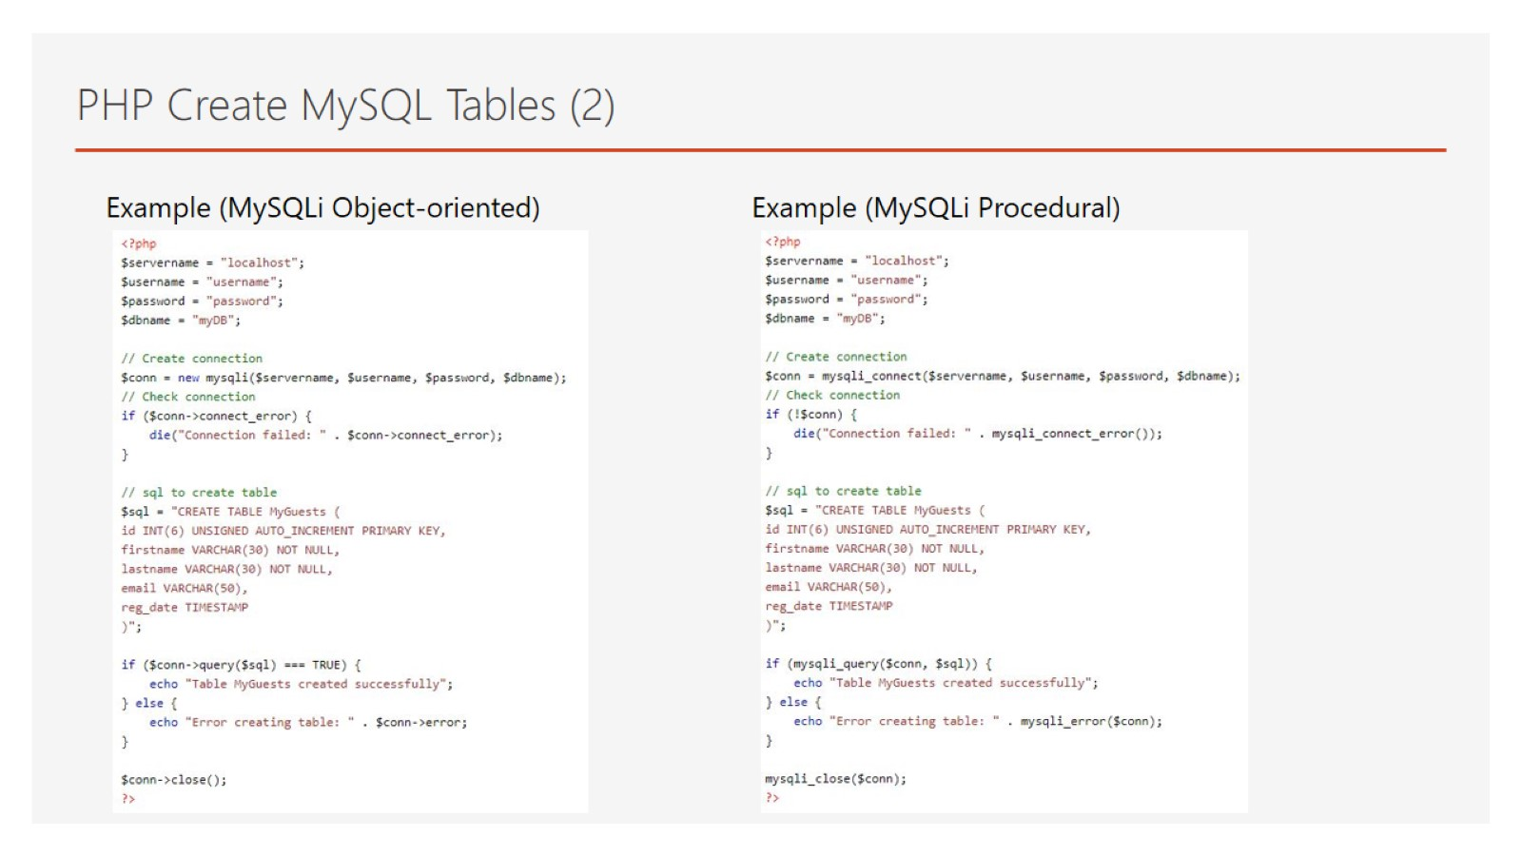
PHP Create MySQL Tables (2)

Slide 13
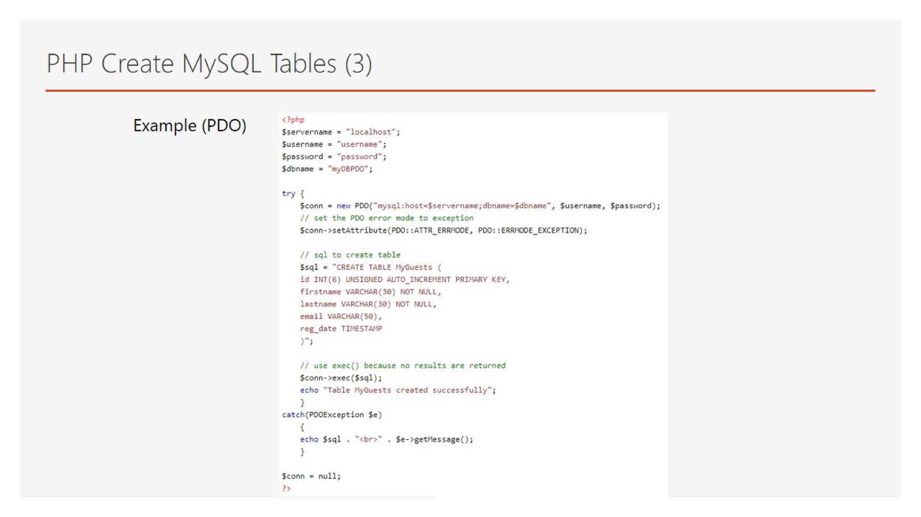
PHP Create MySQL Tables (3)

Slide 14
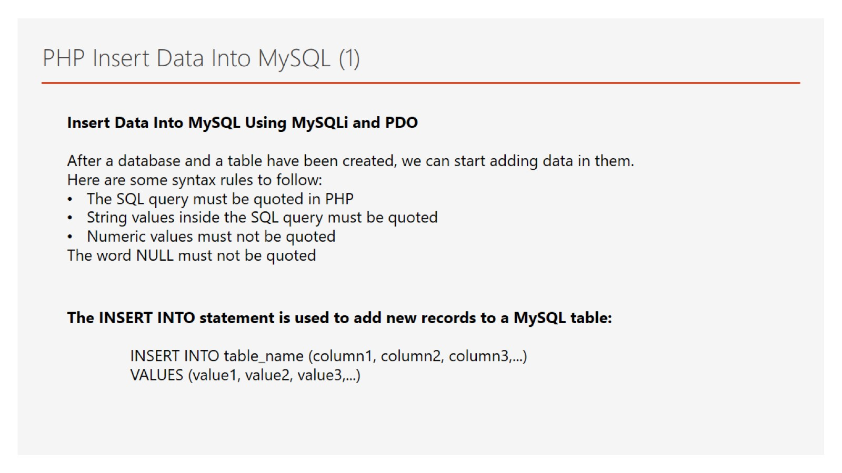
PHP Insert Data Into MySQL (1)

Slide 15
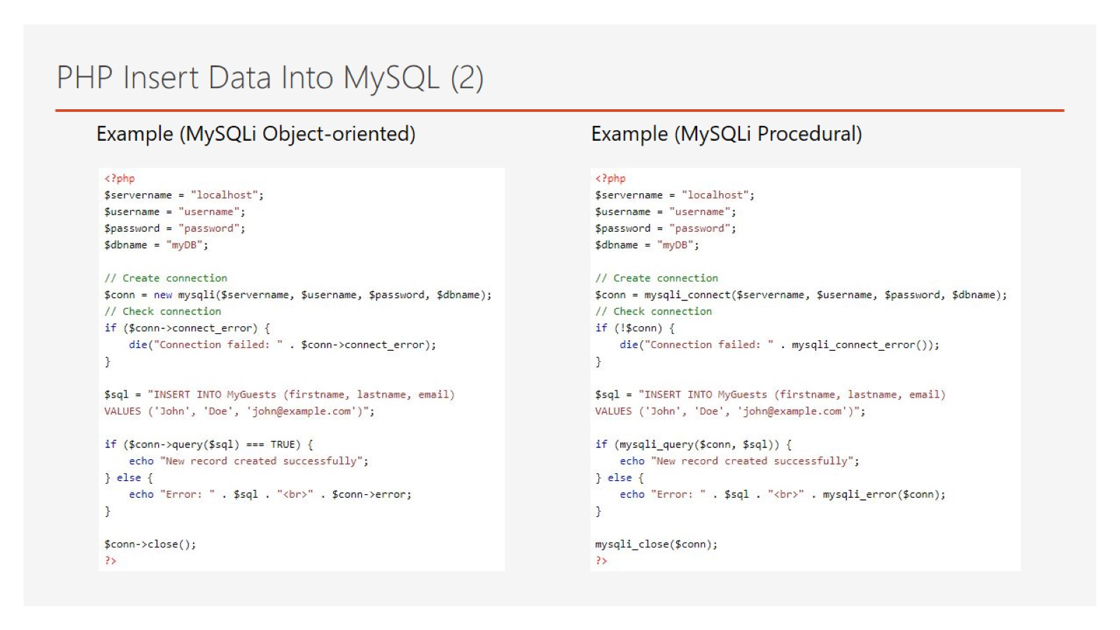
PHP Insert Data Into MySQL (2)

Slide 16
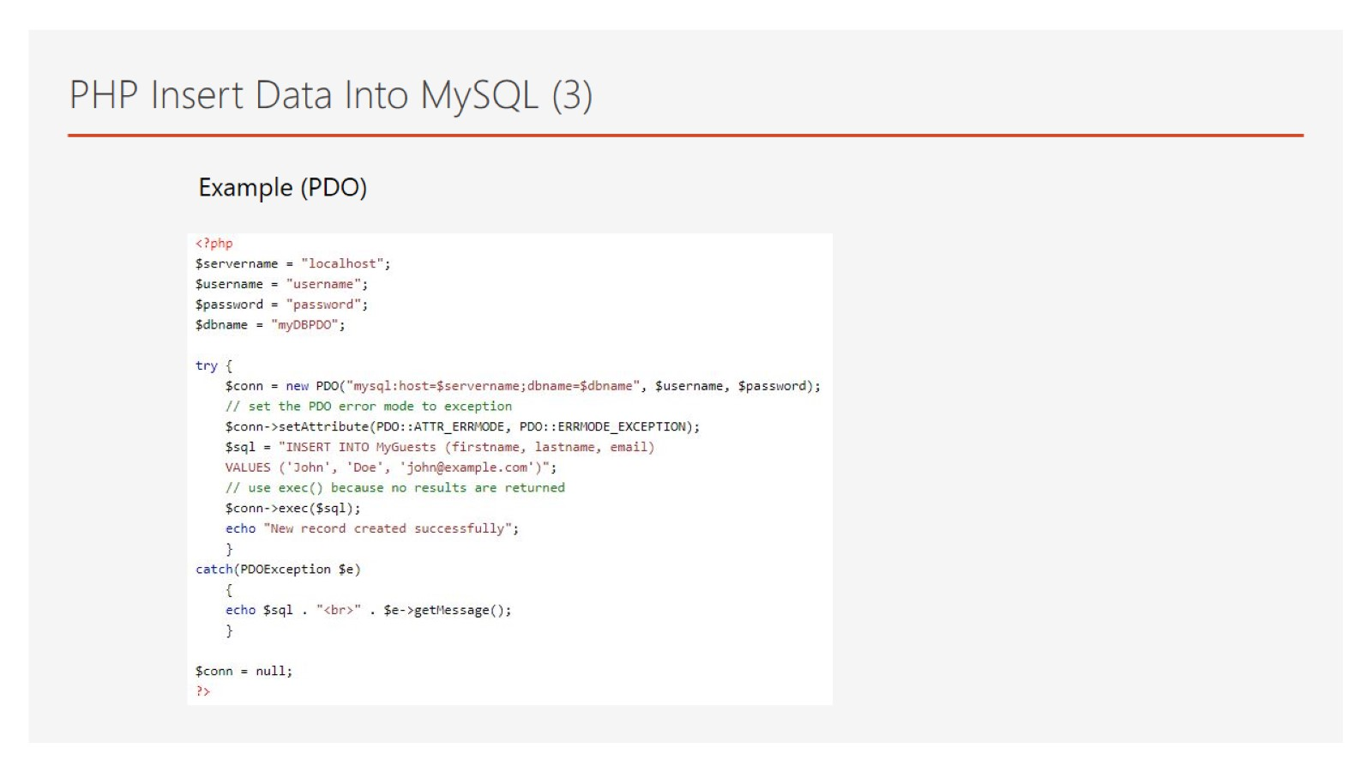
PHP Insert Data Into MySQL (3)

Slide 17
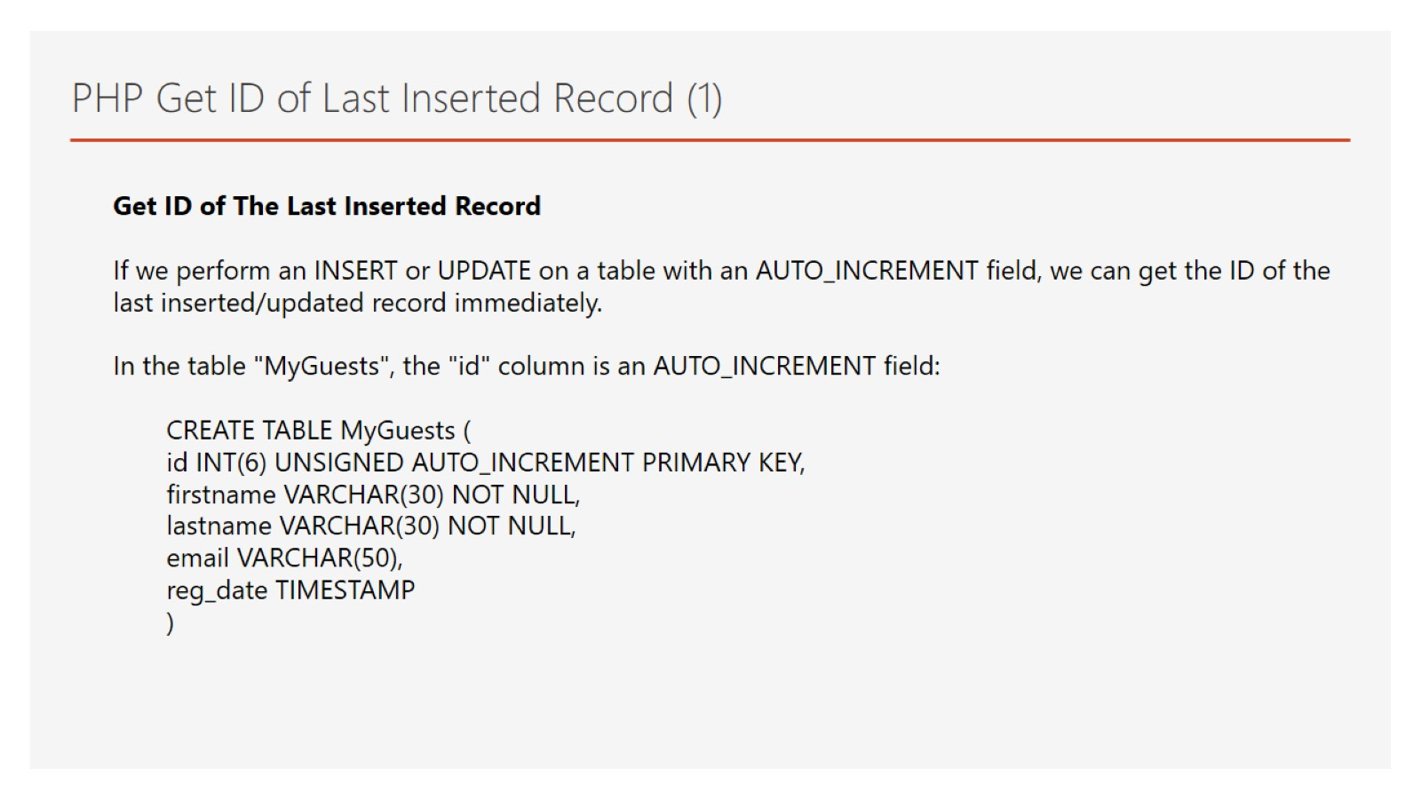
PHP Get ID of Last Inserted Record (1)

Slide 18
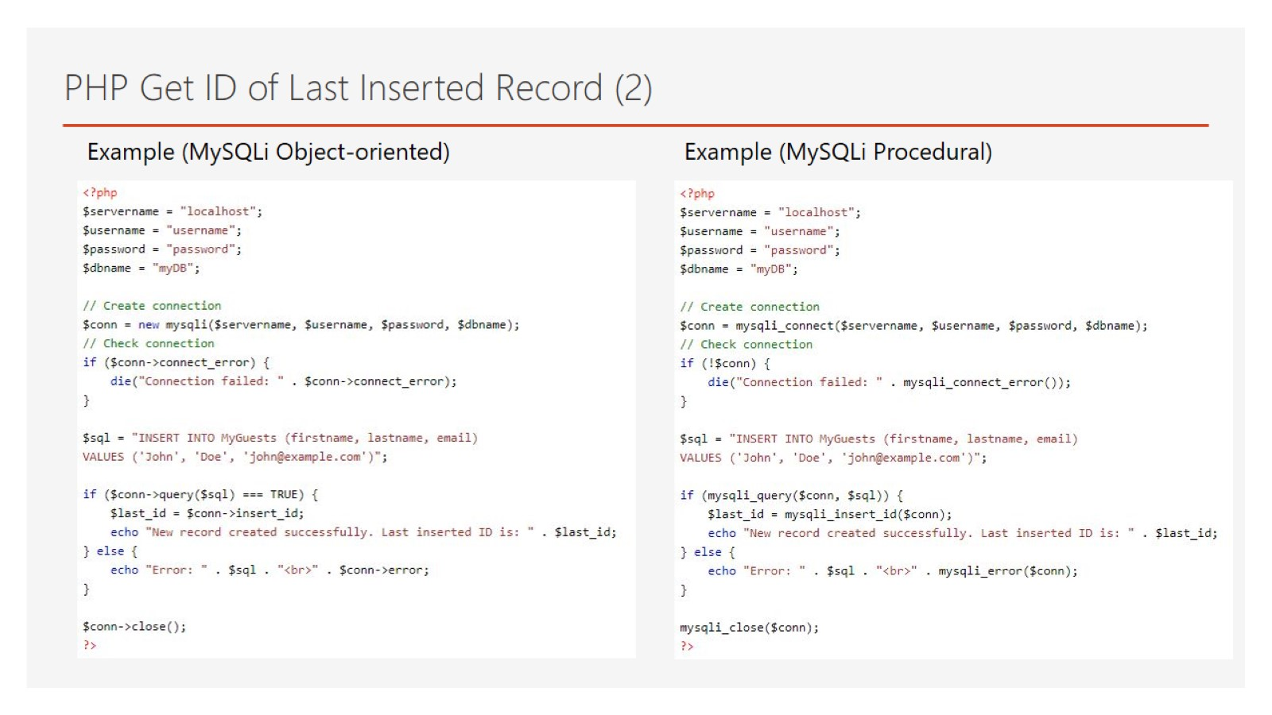
PHP Get ID of Last Inserted Record (2)

Slide 19
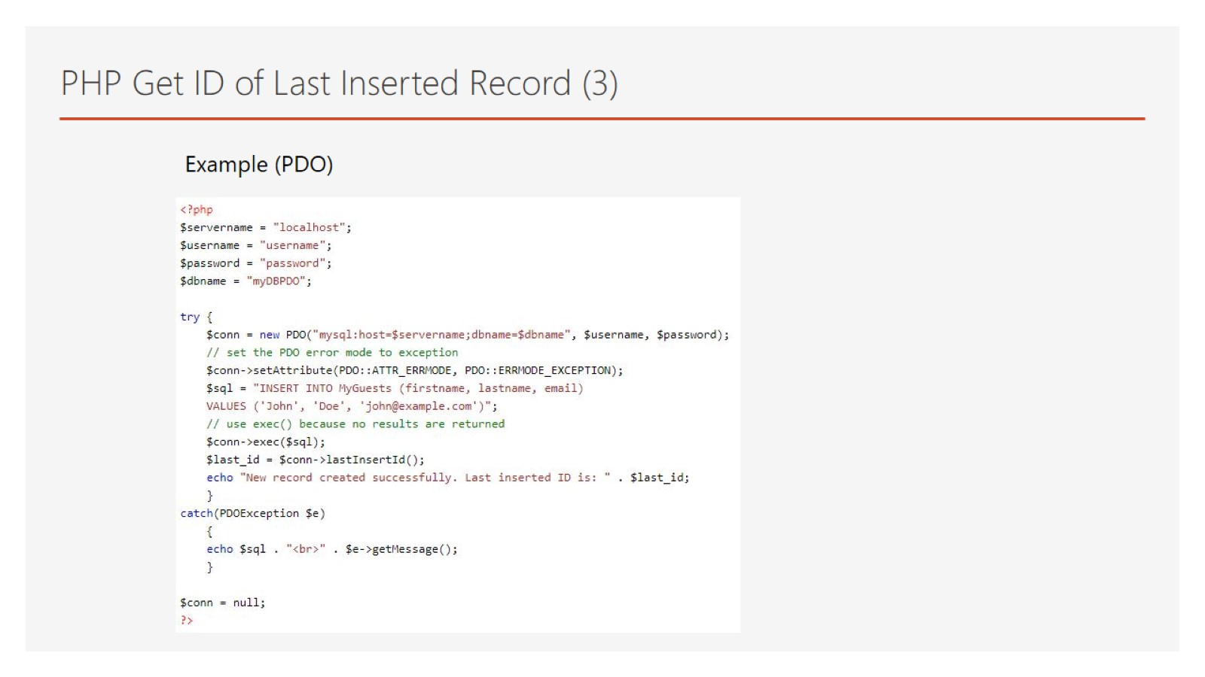
PHP Get ID of Last Inserted Record (3)

Slide 20
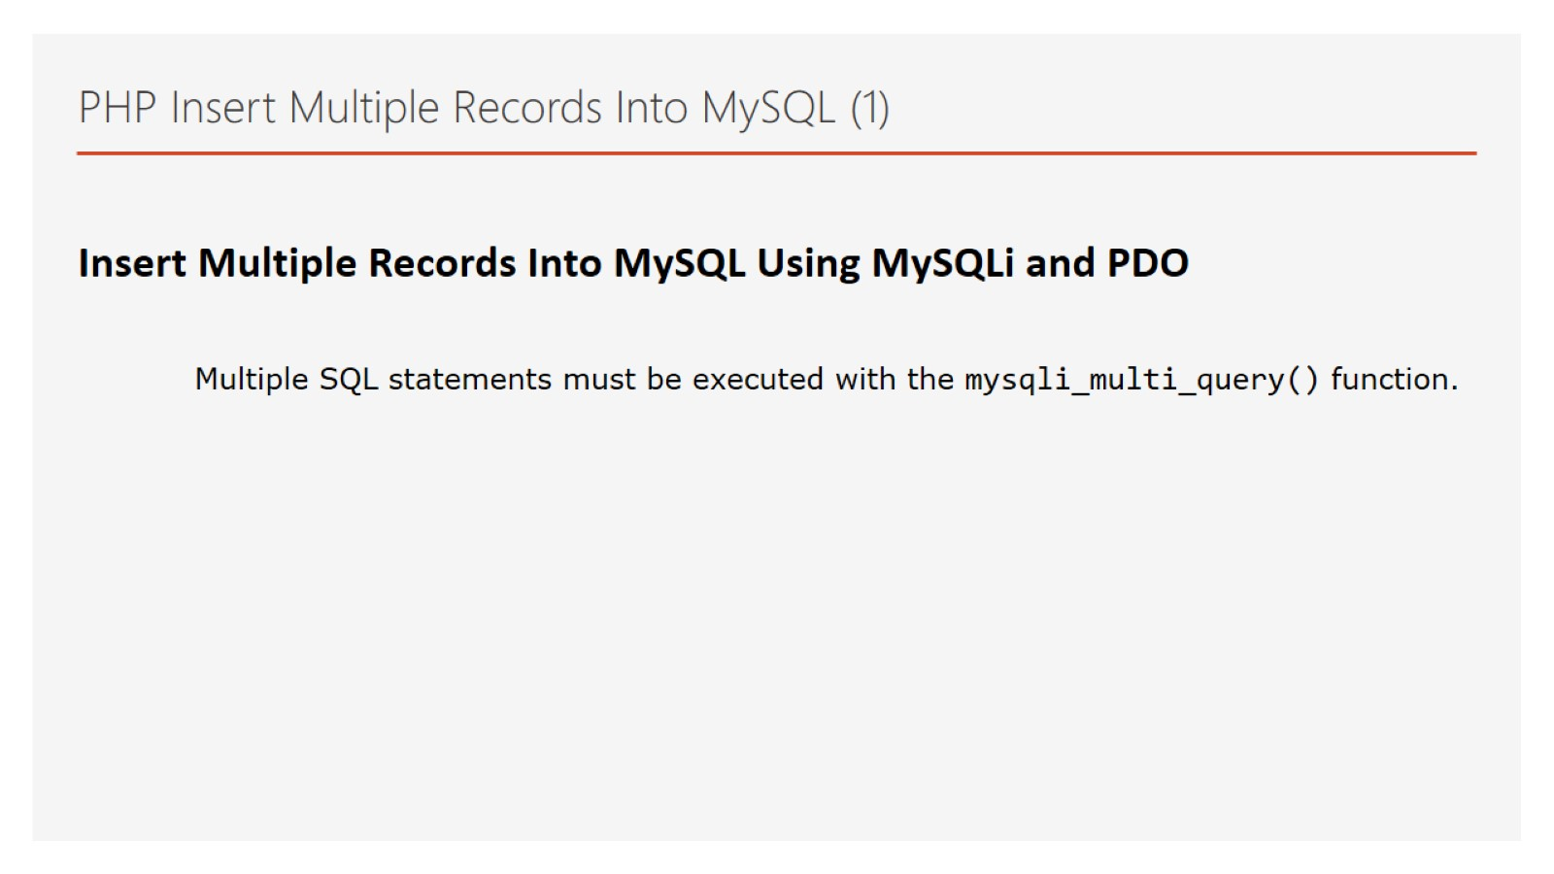
PHP Insert Multiple Records Into MySQL (1)

Slide 21
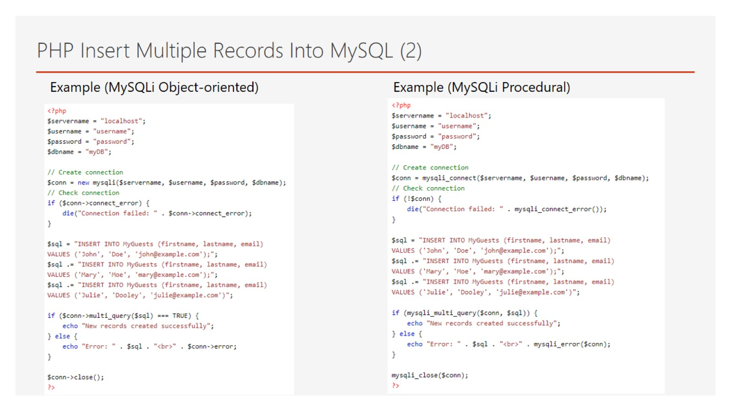
PHP Insert Multiple Records Into MySQL (2)

Slide 22
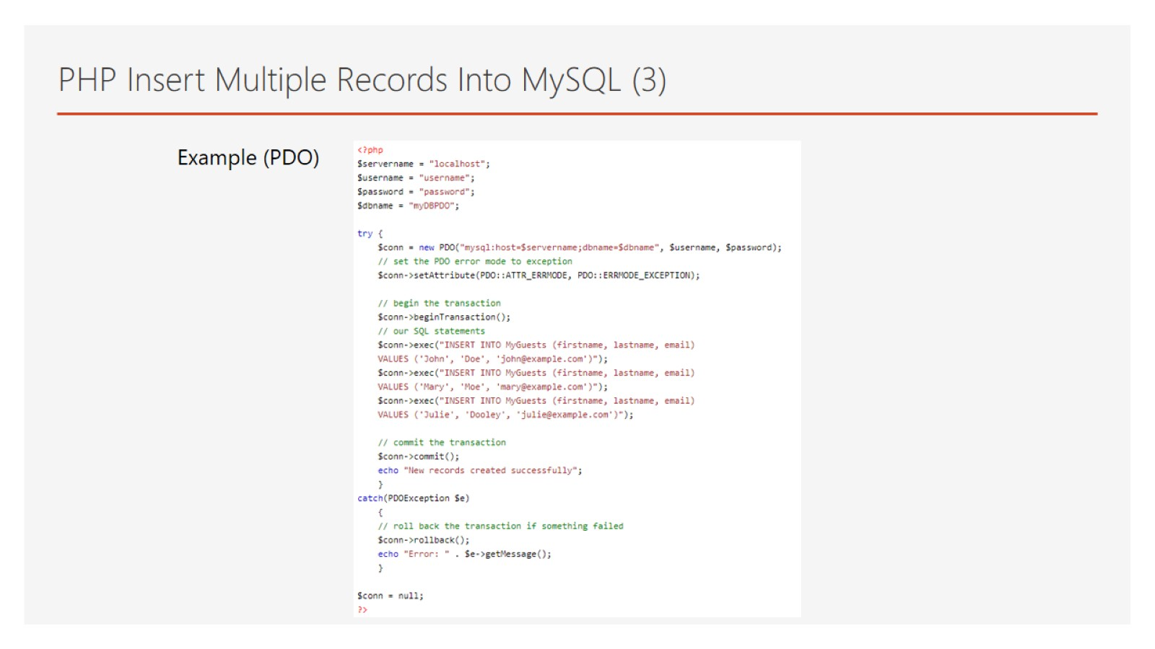
PHP Insert Multiple Records Into MySQL (3)

Slide 23
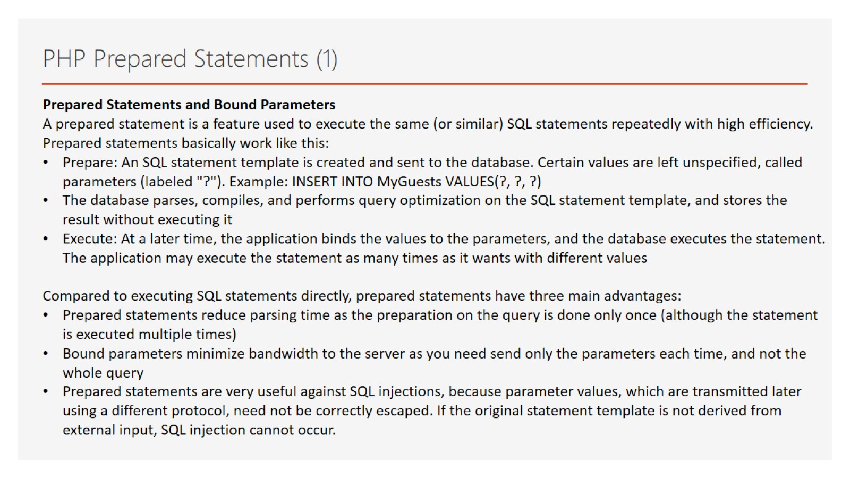
PHP Prepared Statements (1)

Slide 24
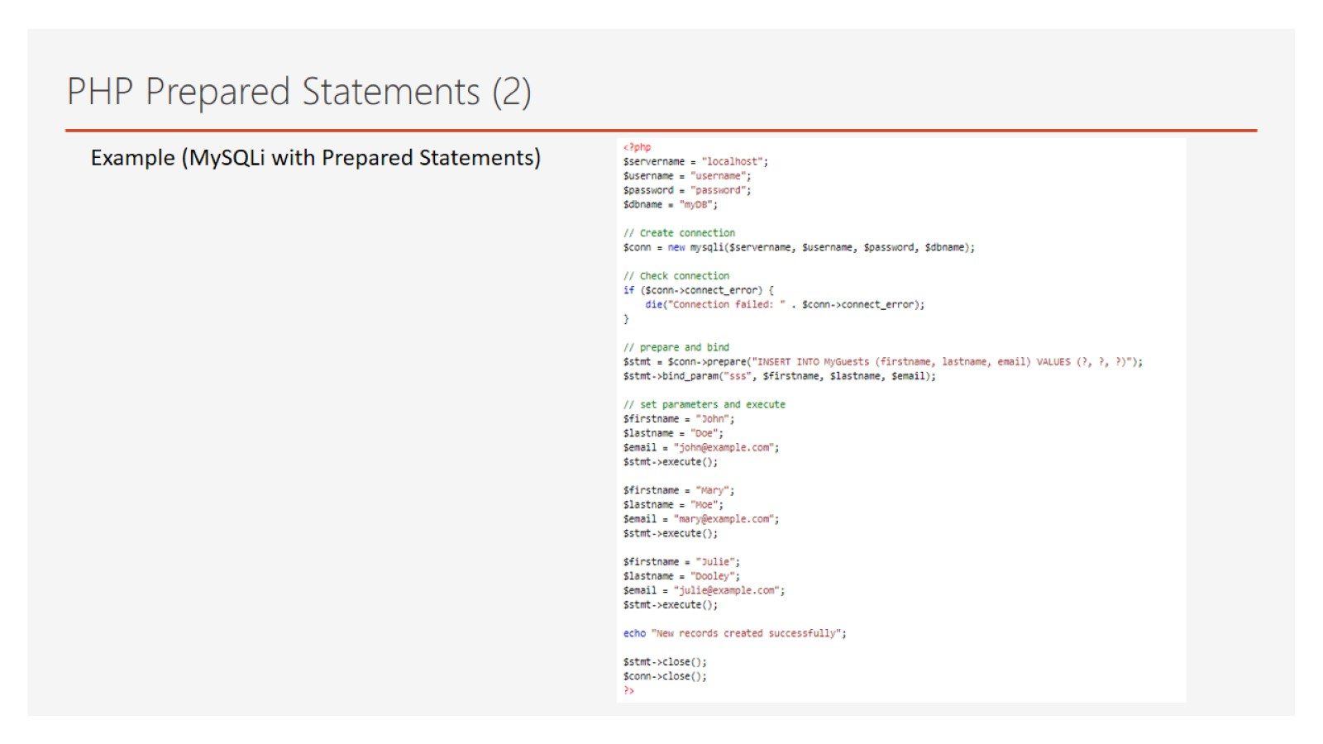
PHP Prepared Statements (2)

Slide 25
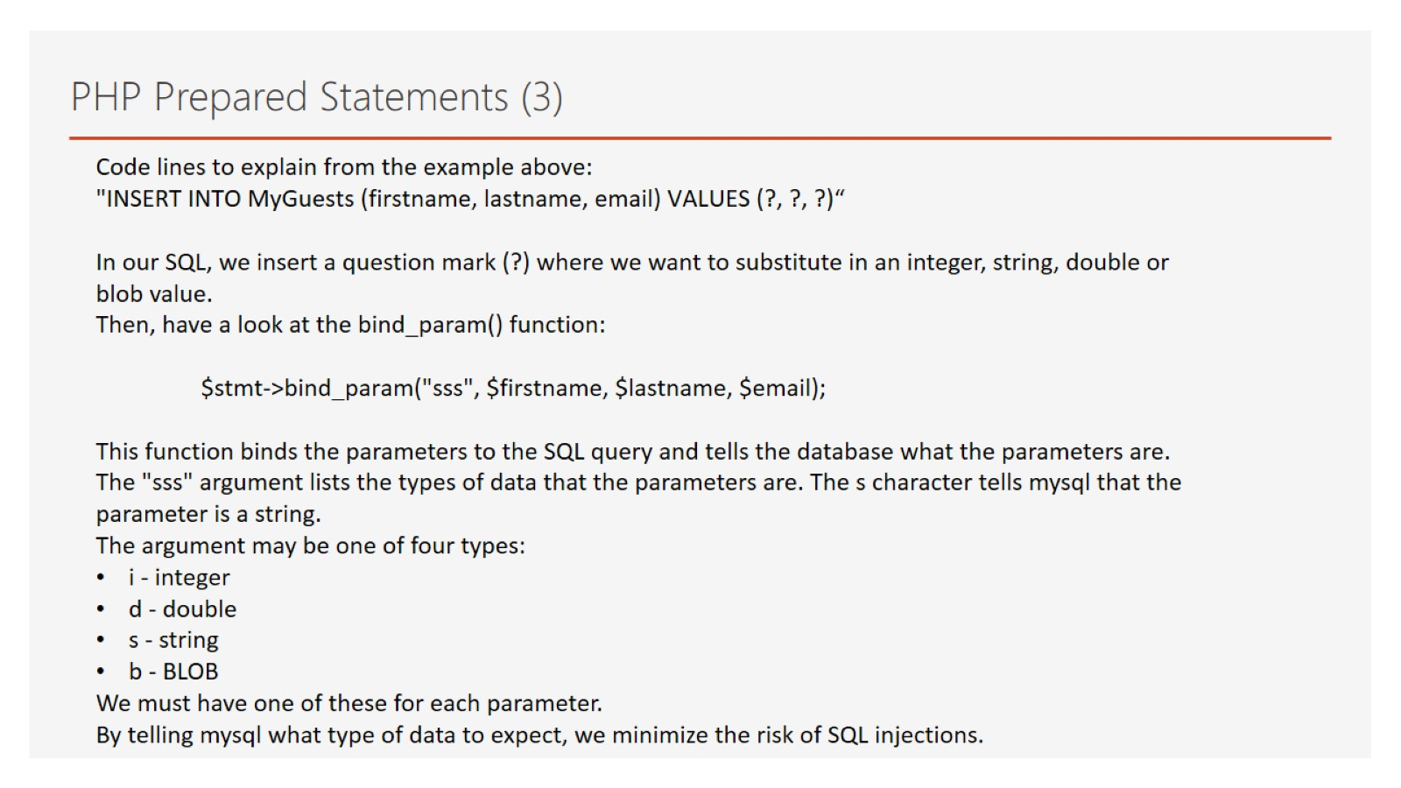
PHP Prepared Statements (3)

Slide 26
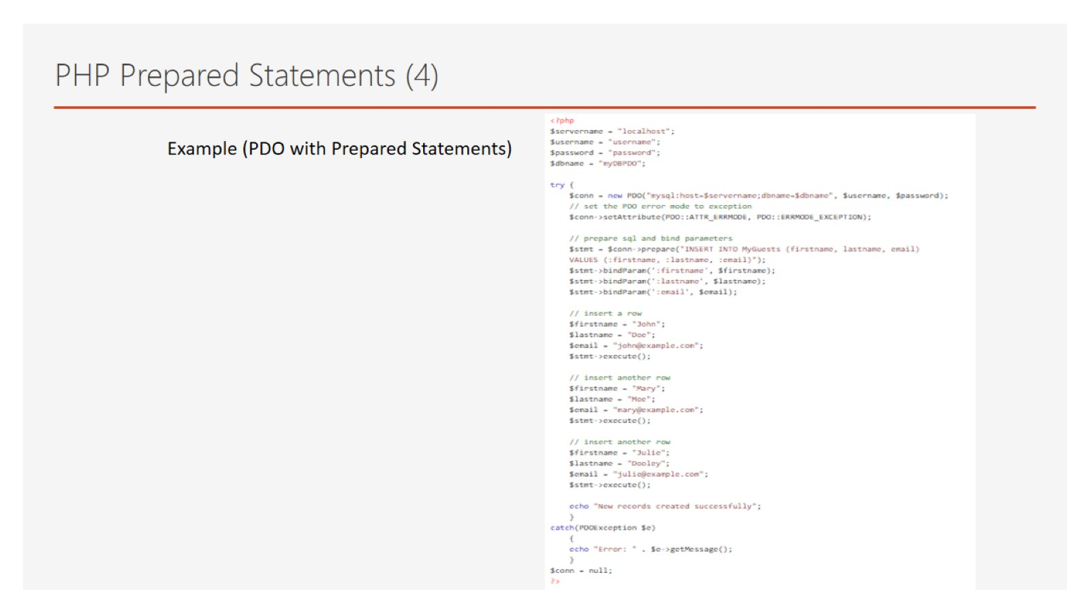
PHP Prepared Statements (4)

Slide 27
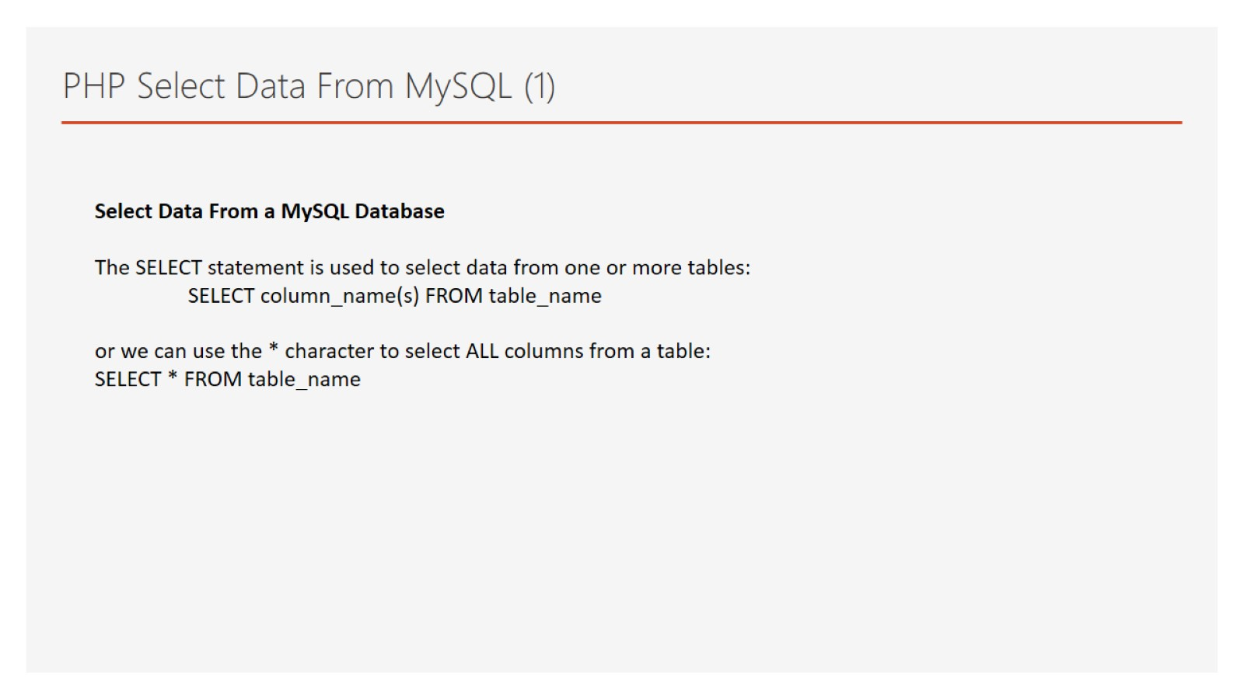
PHP Select Data From MySQL (1)

Slide 28
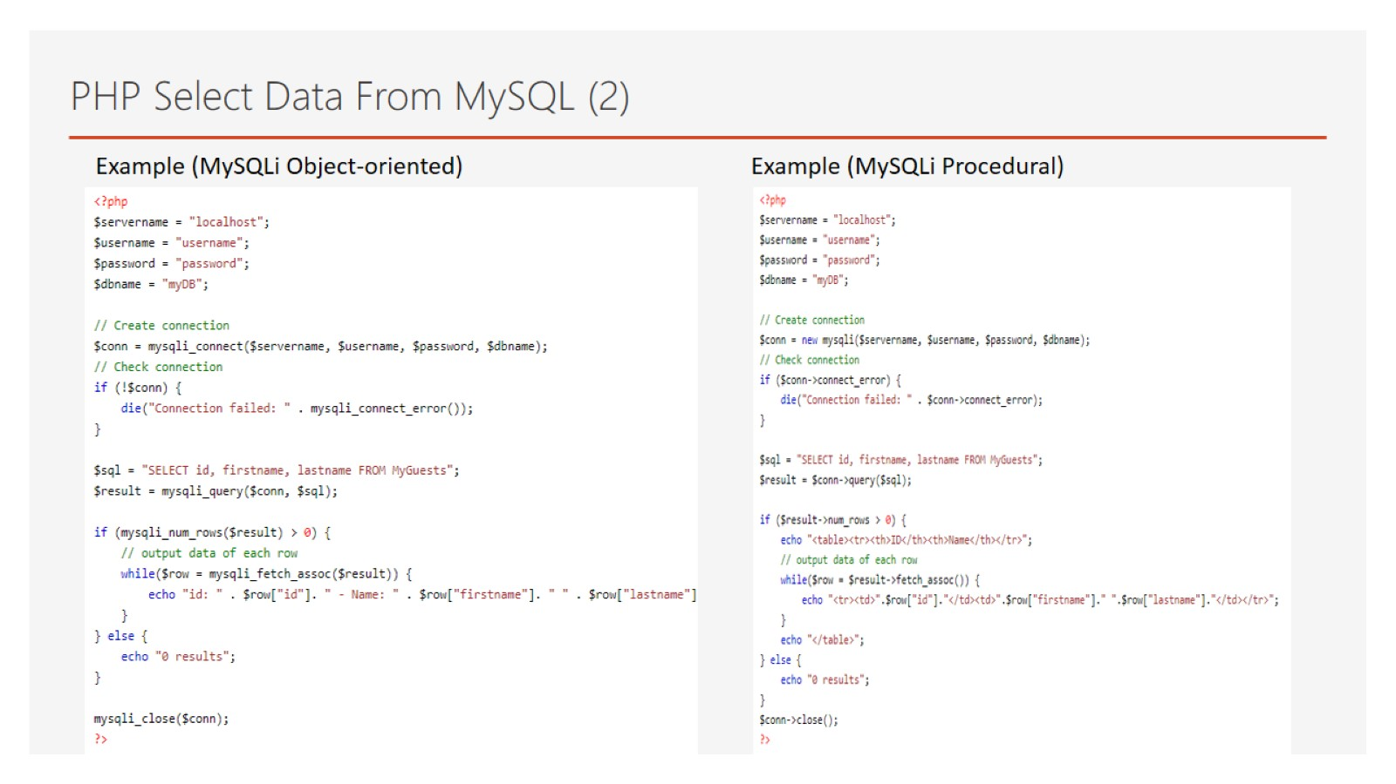
PHP Select Data From MySQL (2)

Slide 29
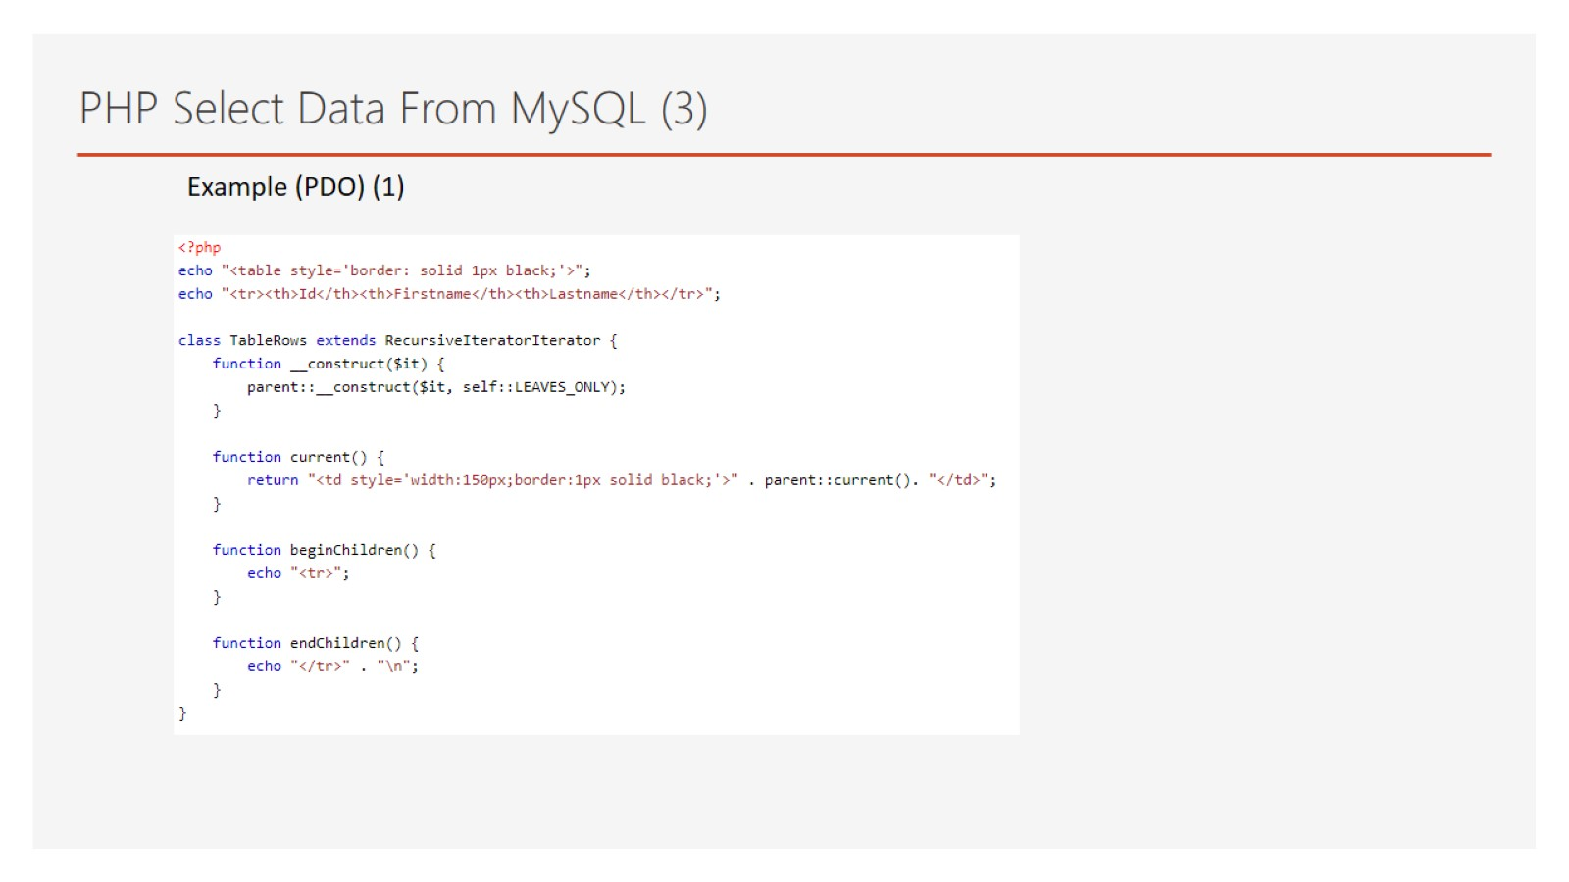
PHP Select Data From MySQL (3)

Slide 30
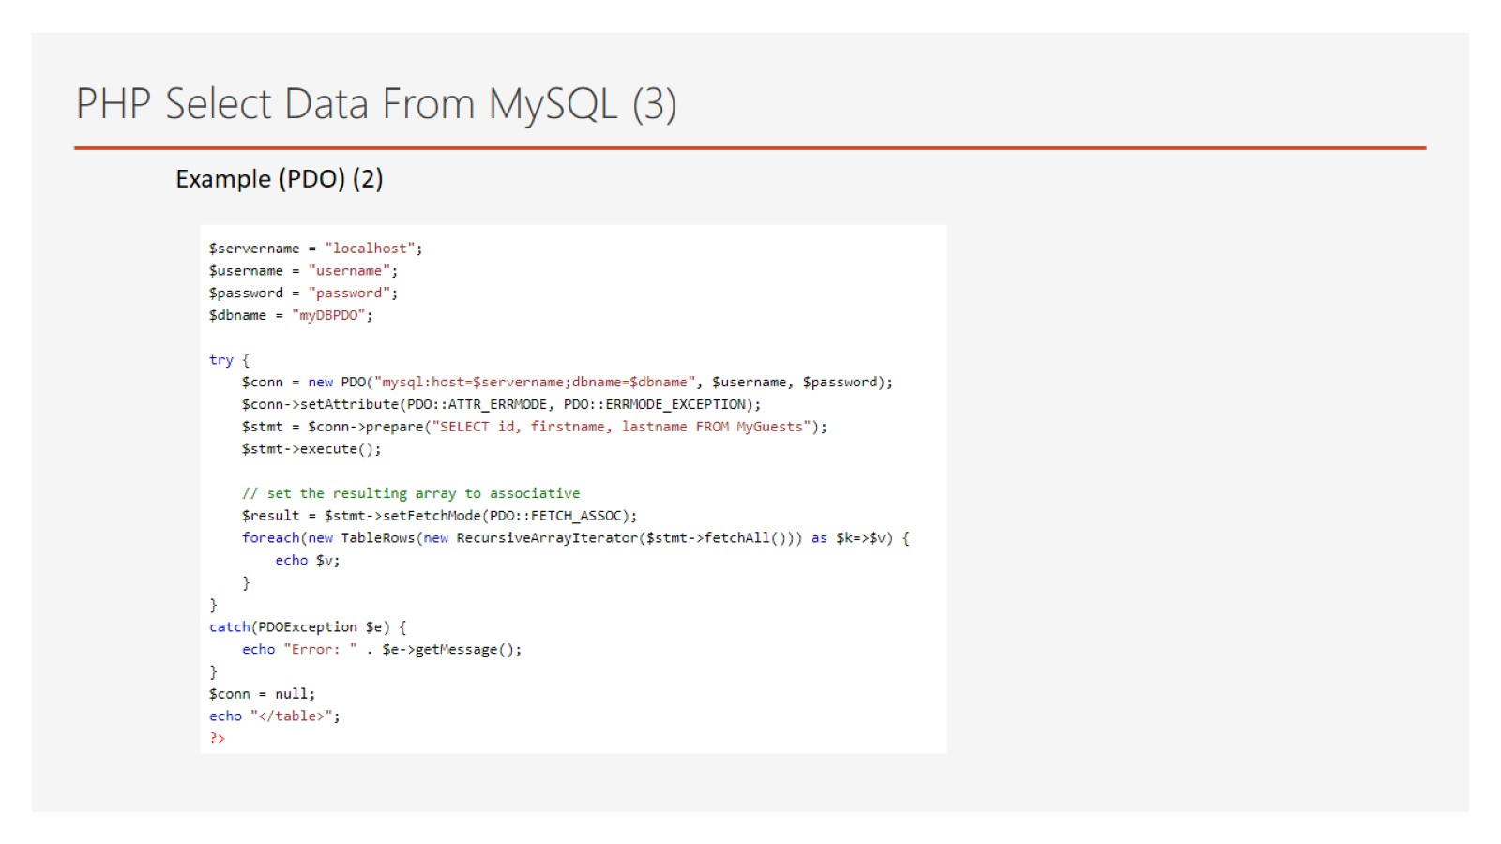
PHP Select Data From MySQL (3)

Slide 31
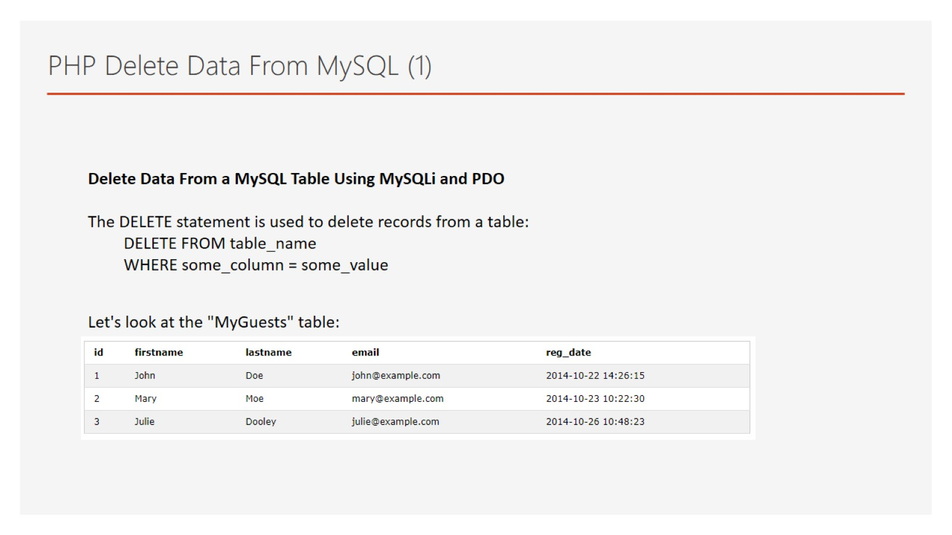
PHP Delete Data From MySQL (1)

Slide 32
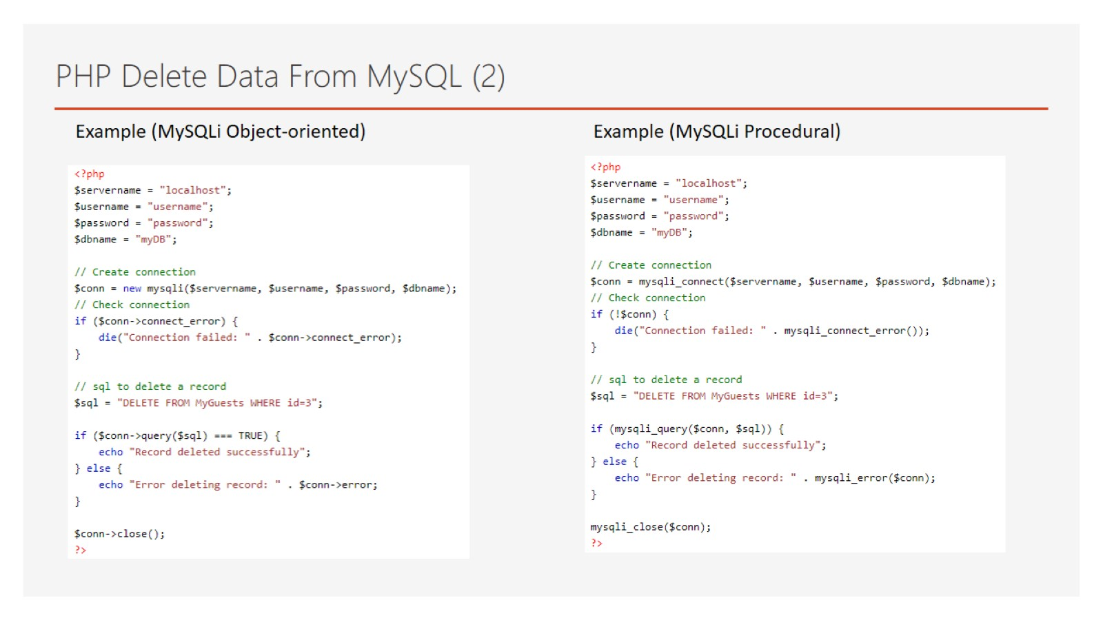
PHP Delete Data From MySQL (2)

Slide 33
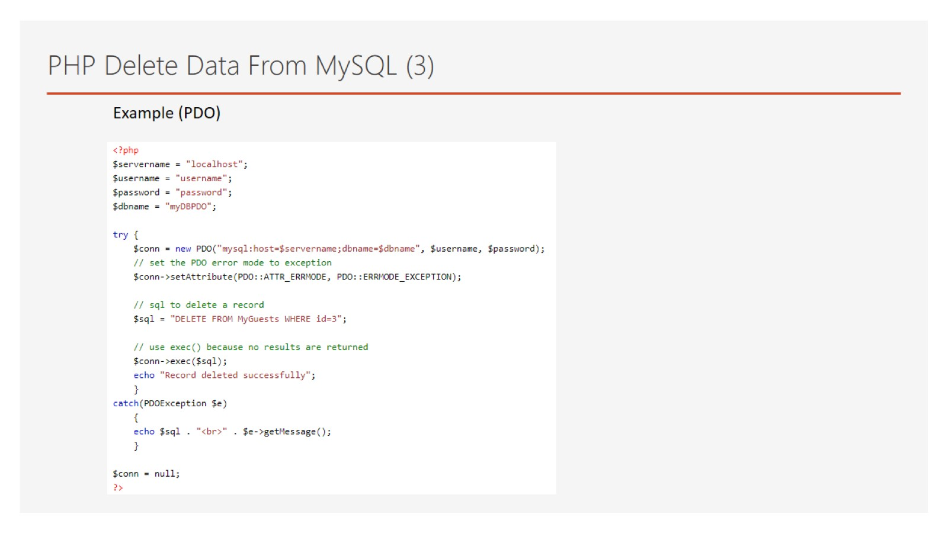
PHP Delete Data From MySQL (3)

Slide 34
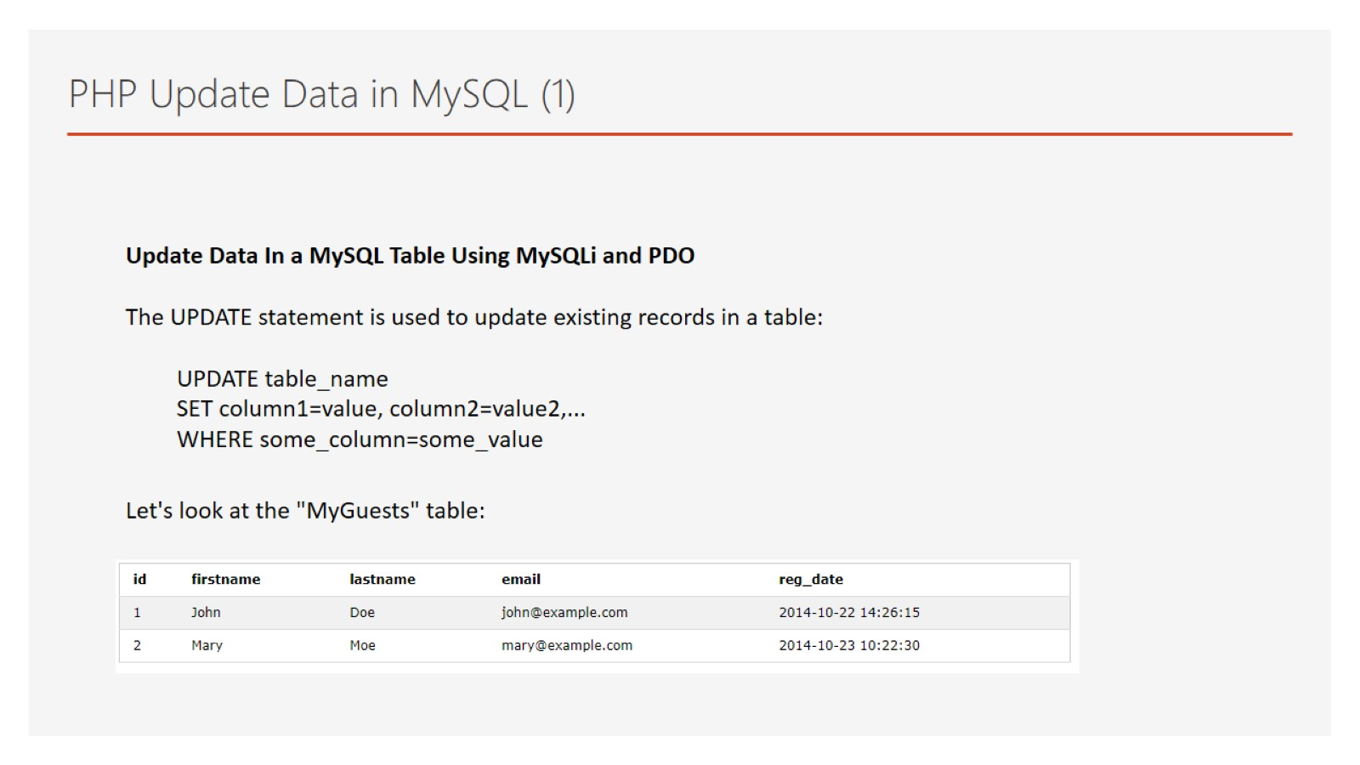
PHP Update Data in MySQL (1)

Slide 35
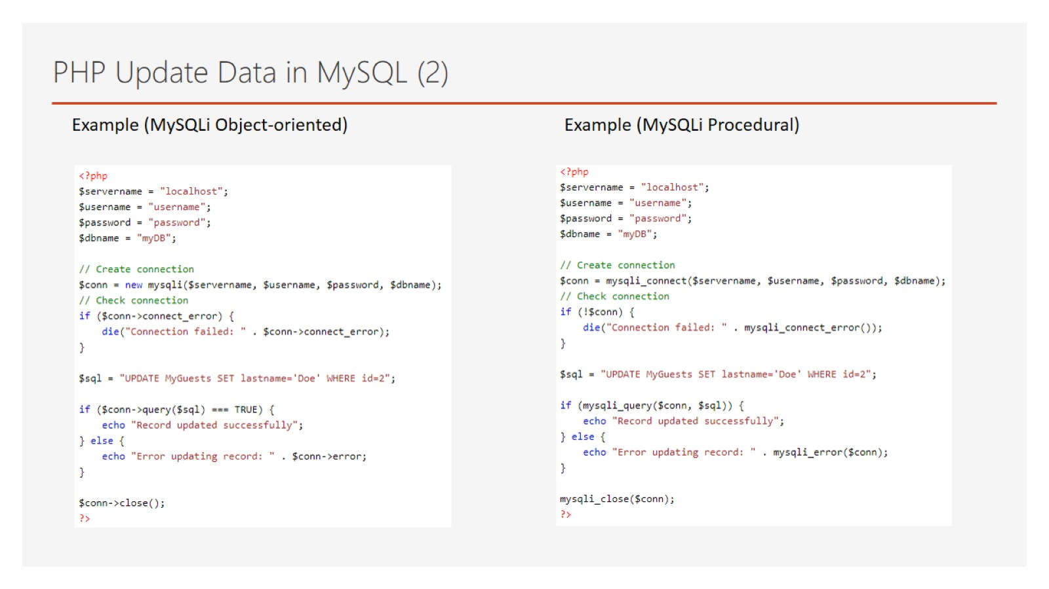
PHP Update Data in MySQL (2)

Slide 36
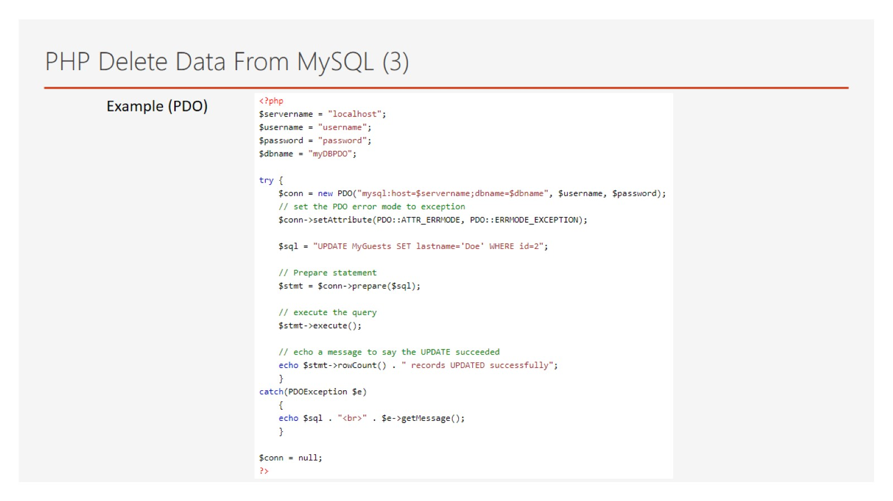
PHP Delete Data From MySQL (3)

Slide 37
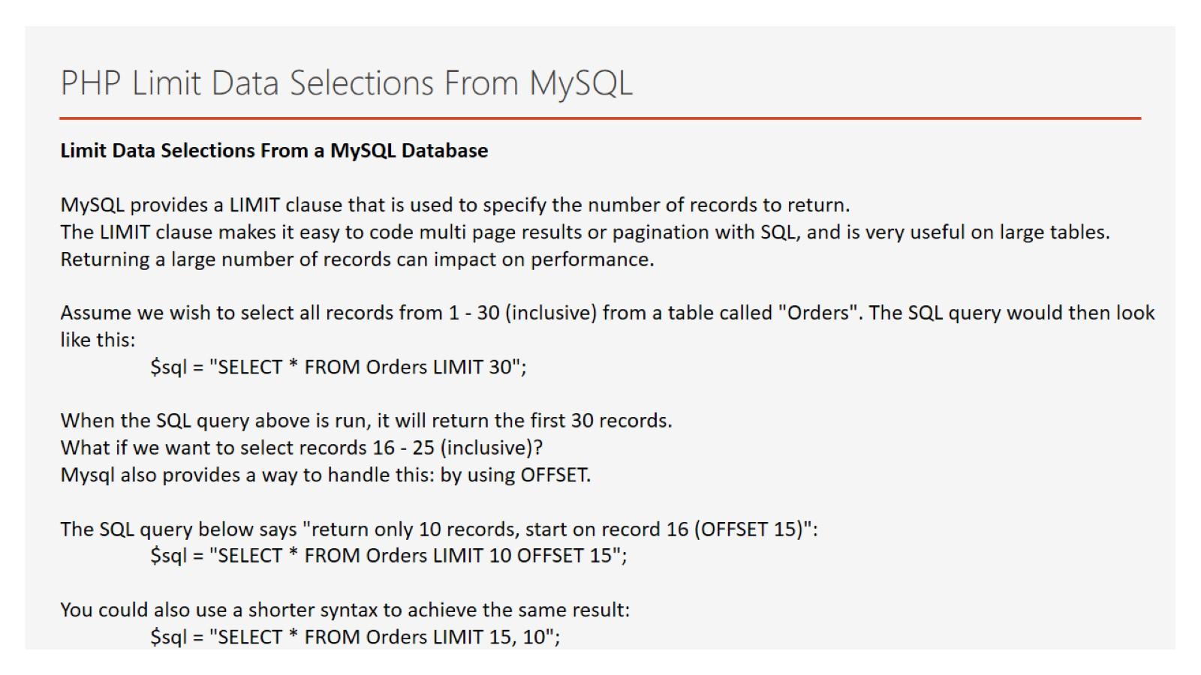
PHP Limit Data Selections From MySQL

Slide 38


